Slide 1
Chapter 9
Applications
Copyright © 2010, Elsevier Inc. All rights Reserved
Notes:
The University of Adelaide, School of Computer Science
Chapter 2 — Instructions: Language of the Computer

Slide 2
Problem
Applications need their own protocols.
These applications are part network protocol (in the sense that they exchange messages with their peers on other machines) and part traditional application program (in the sense that they interact with the windowing system, the file system, and ultimately, the user).
This chapter explores some of the most popular network applications available today.
Notes:
The University of Adelaide, School of Computer Science
Chapter 2 — Instructions: Language of the Computer

Slide 3
Chapter Outline
Traditional Applications
Multimedia Applications
Infrastructure Services
Overlay Networks
Notes:
The University of Adelaide, School of Computer Science
Chapter 2 — Instructions: Language of the Computer

Slide 4
Traditional Applications
Two of the most popular—
  The World Wide Web and
  Email.
Broadly speaking, both of these applications use the request/reply paradigm—users send requests to servers, which then respond accordingly.
Notes:
The University of Adelaide, School of Computer Science
Chapter 2 — Instructions: Language of the Computer

Slide 5
Traditional Applications
It is important to distinguish between application programs and application protocols.
For example, the HyperText Transport Protocol (HTTP) is an application protocol that is used to retrieve Web pages from remote servers.
There can be many different application programs—that is, Web clients like Internet Explorer, Chrome, Firefox, and Safari—that provide users with a different look and feel, but all of them use the same HTTP protocol to communicate with Web servers over the Internet.
Notes:
The University of Adelaide, School of Computer Science
Chapter 2 — Instructions: Language of the Computer

Slide 6
Traditional Applications
Two very widely-used, standardized application protocols:
  SMTP: Simple Mail Transfer Protocol is used to exchange electronic mail.
  HTTP: HyperText Transport Protocol is used to communicate between Web browsers and Web servers.
Notes:
The University of Adelaide, School of Computer Science
Chapter 2 — Instructions: Language of the Computer

Slide 7
Traditional Applications
Electronic Mail (SMTP, MIME, IMAP)
  Email is one of the oldest network applications
  It is important
  (1) to distinguish the user interface (i.e., your mail reader) from the underlying message transfer protocols (such as SMTP or IMAP), and
  (2) to distinguish between this transfer protocol and a companion protocol (RFC 822 and MIME) that defines the format of the messages being exchanged
Notes:
The University of Adelaide, School of Computer Science
Chapter 2 — Instructions: Language of the Computer

Slide 8
Traditional Applications
Electronic Mail (SMTP, MIME, IMAP)
  Message Format
    RFC 822 defines messages to have two parts: a header and a body. Both parts are represented in ASCII text.
    Originally, the body was assumed to be simple text. This is still the case, although RFC 822 has been augmented by MIME to allow the message body to carry all sorts of data.
    This data is still represented as ASCII text, but because it may be an encoded version of, say, a JPEG image, it’s not necessarily readable by human users.
    The message header is a series of <CRLF>-terminated lines. (<CRLF> stands for carriage-return+ line-feed, which are a pair of ASCII control characters often used to indicate the end of a line of text.)
Notes:
The University of Adelaide, School of Computer Science
Chapter 2 — Instructions: Language of the Computer

Slide 9
Traditional Applications
Electronic Mail (SMTP, MIME, IMAP)
  Message Format
    The header is separated from the message body by a blank line. Each header line contains a type and value separated by a colon.
    Many of these header lines are familiar to users since they are asked to fill them out when they compose an email message.
    RFC 822 was extended in 1993 (and updated quite a few times since then) to allow email messages to carry many different types of data: audio, video, images, PDF documents, and so on.
Notes:
The University of Adelaide, School of Computer Science
Chapter 2 — Instructions: Language of the Computer

Slide 10
Traditional Applications
Electronic Mail (SMTP, MIME, IMAP)
  Message Format
    MIME consists of three basic pieces.
      The first piece is a collection of header lines that augment the original set defined by RFC 822.
        These header lines describe, in various ways, the data being carried in the message body. They include MIME-Version: (the version of MIME being used), Content-Description: (a human-readable description of what’s in the message, analogous to the Subject: line), Content-Type: (the type of data contained in the message), and Content-Transfer- Encoding (how the data in the message body is encoded).
      The second piece is definitions for a set of content types (and subtypes). For example, MIME defines two different still image types, denoted image/gif and image/jpeg, each with the obvious meaning.
      The third piece is a way to encode the various data types so they can be shipped in an ASCII email message.
Notes:
The University of Adelaide, School of Computer Science
Chapter 2 — Instructions: Language of the Computer

Slide 11
Traditional Applications
Electronic Mail (SMTP, MIME, IMAP)
  Message Transfer
    For many years, the majority of email was moved from host to host using only SMTP.
    While SMTP continues to play a central role, it is now just one email protocol of several,
    IMAP and POP being two other important protocols for retrieving mail messages.
Notes:
The University of Adelaide, School of Computer Science
Chapter 2 — Instructions: Language of the Computer

Slide 12
Traditional Applications
Electronic Mail (SMTP, MIME, IMAP)
  Message Transfer
    To place SMTP in the right context, we need to identify the key players.
    First, users interact with a mail reader when they compose, file, search, and read their email.
      There are countless mail readers available, just like there are many Web browsers to choose from.
      In the early days of the Internet, users typically logged into the machine on which their mailbox resided, and the mail reader they invoked was a local application program that extracted messages from the file system.
      Today, of course, users remotely access their mailbox from their laptop or smartphone; they do not first log into the host that stores their mail (a mail server).
Notes:
The University of Adelaide, School of Computer Science
Chapter 2 — Instructions: Language of the Computer

Slide 13
Traditional Applications
Electronic Mail (SMTP, MIME, IMAP)
  Message Transfer
    To place SMTP in the right context, we need to identify the key players.
    Second, there is a mail daemon (or process) running on each host that holds a mailbox.
      You can think of this process, also called a message transfer agent (MTA), as playing the role of a post office: users (or their mail readers) give the daemon messages they want to send to other users, the daemon uses SMTP running over TCP to transmit the message to a daemon running on another machine, and the daemon puts incoming messages into the user’s mailbox (where that user’s mail reader can later find it).
      Since SMTP is a protocol that anyone could implement, in theory there could be many different implementations of the mail daemon.
Notes:
The University of Adelaide, School of Computer Science
Chapter 2 — Instructions: Language of the Computer

Slide 14
Traditional Applications
Electronic Mail (SMTP, MIME, IMAP)
  Message Transfer
    While it is certainly possible that the MTA on a sender’s machine establishes an SMTP/TCP connection to the MTA on the recipient’s mail server, in many cases the mail traverses one or more mail gateways on its route from the sender’s host to the receiver’s host.
    Like the end hosts, these gateways also run a message transfer agent process.
    It’s not an accident that these intermediate nodes are called “gateways” since their job is to store and forward email messages, much like an “IP gateway” (which we have referred to as a router) stores and forwards IP datagrams.
Notes:
The University of Adelaide, School of Computer Science
Chapter 2 — Instructions: Language of the Computer

Slide 15
Traditional Applications
Electronic Mail (SMTP, MIME, IMAP)
  Message Transfer (contd.)
    The only difference is that a mail gateway typically buffers messages on disk and is willing to try retransmitting them to the next machine for several days, while an IP router buffers datagrams in memory and is only willing to retry transmitting them for a fraction of a second.
Notes:
The University of Adelaide, School of Computer Science
Chapter 2 — Instructions: Language of the Computer

Slide 16
Traditional Applications
Electronic Mail (SMTP, MIME, IMAP)
  Mail Reader
    The final step is for the user to actually retrieve his or her messages from the mailbox, read them, reply to them, and possibly save a copy for future reference.
    The user performs all these actions by interacting with a mail reader.
    As pointed out earlier, this reader was originally just a program running on the same machine as the user’s mailbox, in which case it could simply read and write the file that implements the mailbox.
    This was the common case in the pre-laptop era.
Notes:
The University of Adelaide, School of Computer Science
Chapter 2 — Instructions: Language of the Computer

Slide 17
Traditional Applications
Electronic Mail (SMTP, MIME, IMAP)
  Mail Reader
    Today, most often the user accesses his or her mailbox from a remote machine using yet another protocol, such as the Post Office Protocol (POP) or the Internet Message Access Protocol (IMAP).
    It is beyond the scope of this book to discuss the user interface aspects of the mail reader, but it is definitely within our scope to talk about the access protocol.
Notes:
The University of Adelaide, School of Computer Science
Chapter 2 — Instructions: Language of the Computer

Slide 18
Traditional Applications
Electronic Mail (SMTP, MIME, IMAP)
  Mail Reader
    IMAP is similar to SMTP in many ways.
    It is a client/server protocol running over TCP, where the client (running on the user’s desktop machine) issues commands in the form of <CRLF>-terminated ASCII text lines and the mail server (running on the machine that maintains the user’s mailbox) responds in-kind.
    The exchange begins with the client authenticating him or herself, and identifying the mailbox he or she wants to access.
Notes:
The University of Adelaide, School of Computer Science
Chapter 2 — Instructions: Language of the Computer

Slide 19
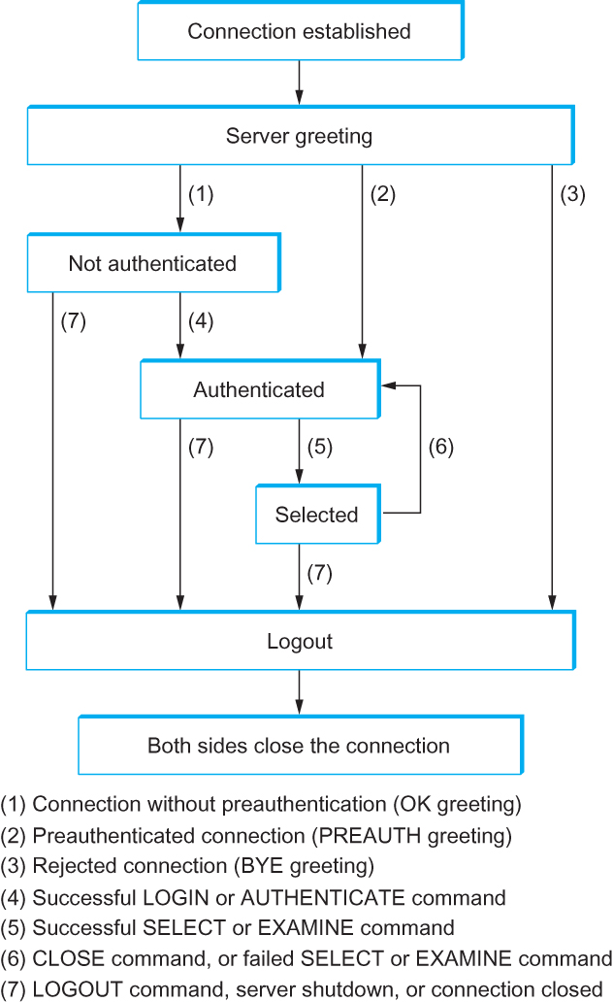
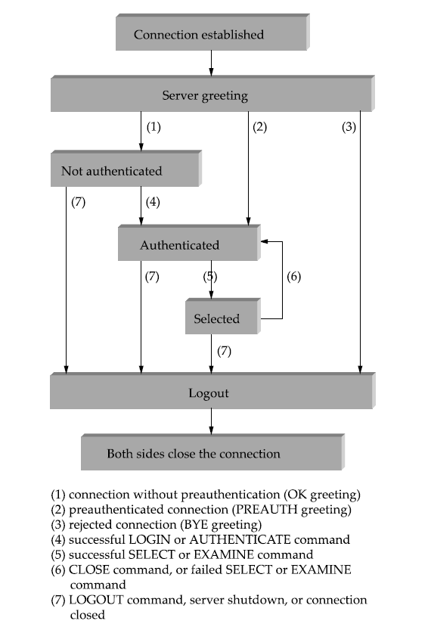
Traditional Applications
Electronic Mail (SMTP, MIME, IMAP)
IMAP State Transition Diagram
Notes:
The University of Adelaide, School of Computer Science
Chapter 2 — Instructions: Language of the Computer

Slide 20
Traditional Applications
World Wide Web
  The World Wide Web has been so successful and has made the Internet accessible to so many people that sometimes it seems to be synonymous with the Internet.
  In fact, the design of the system that became the Web started around 1989, long after the Internet had become a widely deployed system.
  The original goal of the Web was to find a way to organize and retrieve information, drawing on ideas about hypertext—interlinked documents—that had been around since at least the 1960s.
Notes:
The University of Adelaide, School of Computer Science
Chapter 2 — Instructions: Language of the Computer

Slide 21
Traditional Applications
World Wide Web
  The core idea of hypertext is that one document can link to another document, and the protocol (HTTP) and document language (HTML) were designed to meet that goal.
  One helpful way to think of the Web is as a set of cooperating clients and servers, all of whom speak the same language: HTTP.
  Most people are exposed to the Web through a graphical client program, or Web browser, like Safari, Chrome, Firefox or Internet Explorer.
Notes:
The University of Adelaide, School of Computer Science
Chapter 2 — Instructions: Language of the Computer

Slide 22
Traditional Applications
World Wide Web
  Clearly, if you want to organize information into a system of linked documents or objects, you need to be able to retrieve one document to get started.
  Hence, any Web browser has a function that allows the user to obtain an object by “opening a URL.”
  URLs (Uniform Resource Locators) are so familiar to most of us by now that it’s easy to forget that they haven’t been around forever.
  They provide information that allows objects on the Web to be located, and they look like the following:
    http://www.cs.princeton.edu/index.html
Notes:
The University of Adelaide, School of Computer Science
Chapter 2 — Instructions: Language of the Computer

Slide 23
Traditional Applications
World Wide Web
  If you opened that particular URL, your Web browser would open a TCP connection to the Web server at a machine called www.cs.princeton.edu and immediately retrieve and display the file called index.html.
  Most files on the Web contain images and text and many have other objects such as audio and video clips, pieces of code, etc.
  They also frequently include URLs that point to other files that may be located on other machines, which is the core of the “hypertext” part of HTTP and HTML.
Notes:
The University of Adelaide, School of Computer Science
Chapter 2 — Instructions: Language of the Computer

Slide 24
Traditional Applications
World Wide Web
  When you ask your browser to view a page, your browser (the client) fetches the page from the server using HTTP running over TCP.
  Like SMTP, HTTP is a text oriented protocol.
  At its core, HTTP is a request/response protocol, where every message has the general form
  START_LINE <CRLF>
  MESSAGE_HEADER <CRLF>
  <CRLF>
  MESSAGE_BODY <CRLF>
  where as before,<CRLF>stands for carriage-return-line-feed.The first line (START LINE)
  indicates whether this is a request message or a response message.
Notes:
The University of Adelaide, School of Computer Science
Chapter 2 — Instructions: Language of the Computer

Slide 25
Traditional Applications
World Wide Web
  Request Messages
    The first line of an HTTP request message specifies three things: the operation to be performed, the Web page the operation should be performed on, and the version of HTTP being used.
    Although HTTP defines a wide assortment of possible request operations—including “write” operations that allow a Web page to be posted on a server—the two most common operations are GET (fetch the specified Web page) and HEAD (fetch status information about the specified Web page).
Notes:
The University of Adelaide, School of Computer Science
Chapter 2 — Instructions: Language of the Computer

Slide 26
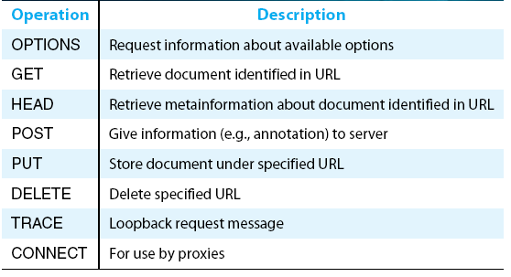
Traditional Applications
World Wide Web
  Request Messages
HTTP request operations
Notes:
The University of Adelaide, School of Computer Science
Chapter 2 — Instructions: Language of the Computer

Slide 27
Traditional Applications
World Wide Web
  Response Messages
    Like request messages, response messages begin with a single START LINE.
    In this case, the line specifies the version of HTTP being used, a three-digit code indicating whether or not the request was successful, and a text string giving the reason for the response.
Notes:
The University of Adelaide, School of Computer Science
Chapter 2 — Instructions: Language of the Computer

Slide 28
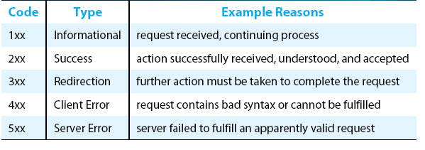
Traditional Applications
World Wide Web
  Response Messages
Five types of HTTP result codes
Notes:
The University of Adelaide, School of Computer Science
Chapter 2 — Instructions: Language of the Computer

Slide 29
Traditional Applications
World Wide Web
  Uniform Resource Identifiers
    The URLs that HTTP uses as addresses are one type of Uniform Resource Identifier (URI).
    A URI is a character string that identifies a resource, where a resource can be anything that has identity, such as a document, an image, or a service.
    The format of URIs allows various more-specialized kinds of resource identifiers to be incorporated into the URI space of identifiers.
    The first part of a URI is a scheme that names a particular way of identifying a certain kind of resource, such as mailto for email addresses or file for file names.
    The second part of a URI, separated from the first part by a colon, is the scheme-specific part.
Notes:
The University of Adelaide, School of Computer Science
Chapter 2 — Instructions: Language of the Computer

Slide 30
Traditional Applications
World Wide Web
  TCP Connections
    The original version of HTTP (1.0) established a separate TCP connection for each data item retrieved from the server.
    It’s not too hard to see how this was a very inefficient mechanism: connection setup and teardown messages had to be exchanged between the client and server even if all the client wanted to do was verify that it had the most recent copy of a page.
    Thus, retrieving a page that included some text and a dozen icons or other small graphics would result in 13 separate TCP connections being established and closed.
Notes:
The University of Adelaide, School of Computer Science
Chapter 2 — Instructions: Language of the Computer

Slide 31
Traditional Applications
World Wide Web
  TCP Connections
    To overcome this situation, HTTP version 1.1 introduced persistent connections— the client and server can exchange multiple request/response messages over the same TCP connection.
    Persistent connections have many advantages.
      First, they obviously eliminate the connection setup overhead, thereby reducing the load on the server, the load on the network caused by the additional TCP packets, and the delay perceived by the user.
      Second, because a client can send multiple request messages down a single TCP connection, TCP’s congestion window mechanism is able to operate more efficiently.
        This is because it’s not necessary to go through the slow start phase for each page.
Notes:
The University of Adelaide, School of Computer Science
Chapter 2 — Instructions: Language of the Computer

Slide 32
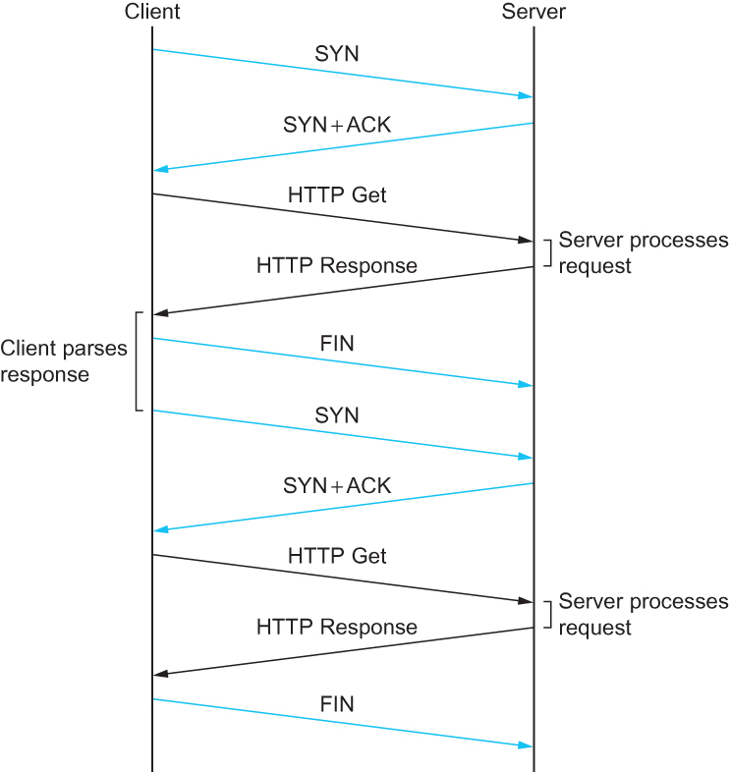
Traditional Applications
World Wide Web
  TCP Connections
HTTP 1.0 behavior
Notes:
The University of Adelaide, School of Computer Science
Chapter 2 — Instructions: Language of the Computer

Slide 33
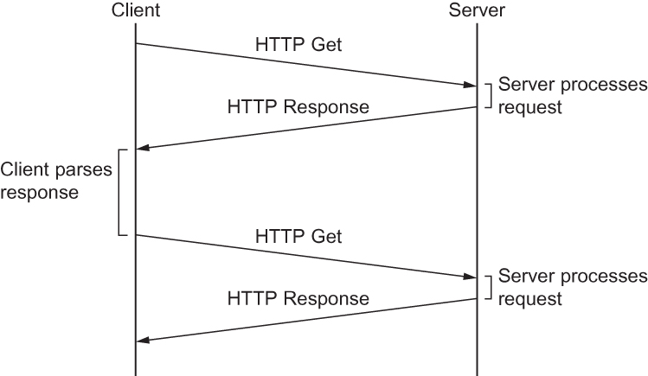
Traditional Applications
World Wide Web
  TCP Connections
HTTP 1.1 behavior with persistent connections
Notes:
The University of Adelaide, School of Computer Science
Chapter 2 — Instructions: Language of the Computer

Slide 34
Traditional Applications
World Wide Web
  Caching
    One of the most active areas of research (and entrepreneurship) in the Internet today is how to effectively cache Web pages.
    Caching has many benefits. From the client’s perspective, a page that can be retrieved from a nearby cache can be displayed much more quickly than if it has to be fetched from across the world.
    From the server’s perspective, having a cache intercept and satisfy a request reduces the load on the server.
Notes:
The University of Adelaide, School of Computer Science
Chapter 2 — Instructions: Language of the Computer

Slide 35
Traditional Applications
World Wide Web
  Caching
    Caching can be implemented in many different places. For example, a user’s browser can cache recently accessed pages, and simply display the cached copy if the user visits the same page again.
    As another example, a site can support a single site-wide cache.
    This allows users to take advantage of pages previously downloaded by other users.
    Closer to the middle of the Internet, ISPs can cache pages.
    Note that in the second case, the users within the site most likely know what machine is caching pages on behalf of the site, and they configure their browsers to connect directly to the caching host. This node is sometimes called a proxy
Notes:
The University of Adelaide, School of Computer Science
Chapter 2 — Instructions: Language of the Computer

Slide 36
Traditional Applications
Web Services
  Much of the motivation for enabling direct application-to-application communication comes from the business world.
  Historically, interactions between enterprises—businesses or other organizations—have involved some manual steps such as filling out an order form or making a phone call to determine whether some product is in stock.
  Even within a single enterprise it is common to have manual steps between software systems that cannot interact directly because they were developed independently.
Notes:
The University of Adelaide, School of Computer Science
Chapter 2 — Instructions: Language of the Computer

Slide 37
Traditional Applications
Web Services
  Increasingly such manual interactions are being replaced with direct application-to application interaction.
  An ordering application at enterprise A would send a message to an order fulfillment application at enterprise B, which would respond immediately indicating whether the order can be filled.
  Perhaps, if the order cannot be filled by B, the application at A would immediately order from another supplier, or solicit bids from a collection of suppliers.
Notes:
The University of Adelaide, School of Computer Science
Chapter 2 — Instructions: Language of the Computer

Slide 38
Traditional Applications
Web Services
  Two architectures have been advocated as solutions to this problem.
  Both architectures are called Web Services, taking their name from the term for the individual applications that offer a remotely-accessible service to client applications to form network applications.
  The terms used as informal shorthand to distinguish the two Web Services architectures are SOAP and REST (as in, “the SOAP vs. REST debate”).
Notes:
The University of Adelaide, School of Computer Science
Chapter 2 — Instructions: Language of the Computer

Slide 39
Traditional Applications
Web Services
  The SOAP architecture’s approach to the problem is to make it feasible, at least in theory, to generate protocols that are customized to each network application.
  The key elements of the approach are a framework for protocol specification, software toolkits for automatically generating protocol implementations from the specifications, and modular partial specifications that can be reused across protocols.
Notes:
The University of Adelaide, School of Computer Science
Chapter 2 — Instructions: Language of the Computer

Slide 40
Traditional Applications
Web Services
  The REST architecture’s approach to the problem is to regard individual Web Services as World Wide Web resources—identified by URIs and accessed via HTTP.
  Essentially, the REST architecture is just the Web architecture.
  The Web architecture’s strengths include stability and a demonstrated scalability (in the network-size sense).
Notes:
The University of Adelaide, School of Computer Science
Chapter 2 — Instructions: Language of the Computer

Slide 41
Traditional Applications
Custom Application Protocols (WSDL, SOAP)
  The architecture informally referred to as SOAP is based on Web Services Description Language (WSDL) and SOAP.4
  Both of these standards are issued by the World Wide Web Consortium (W3C).
  This is the architecture that people usually mean when they use the term Web Services without any preceding qualifier.
Notes:
The University of Adelaide, School of Computer Science
Chapter 2 — Instructions: Language of the Computer

Slide 42
Multimedia Applications
Just like the traditional applications described earlier in this chapter, multimedia applications such as telephony and videoconferencing need their own protocols.
We have already seen a number of protocols that multimedia applications use.
The Real-Time Transport Protocol (RTP) provides many of the functions that are common to multimedia applications such as conveying timing information and identifying the coding schemes and media types of an application.
Notes:
The University of Adelaide, School of Computer Science
Chapter 2 — Instructions: Language of the Computer

Slide 43
Multimedia Applications
The Resource Reservation Protocol, RSVP can be used to request the allocation of resources in the network so that the desired quality of service (QoS) can be provided to an application.
In addition to these protocols for multimedia transport and resource allocation, many multimedia applications also need a signalling or session control protocol.
For example, suppose that we wanted to be able to make telephone calls across the internet (“voice over IP” or VOIP).
Notes:
The University of Adelaide, School of Computer Science
Chapter 2 — Instructions: Language of the Computer

Slide 44
Multimedia Applications
Session Control and Call Control (SDP, SIP, H.323)
  To understand some of the issues of session control, consider the following problem.
    Suppose you want to hold a videoconference at a certain time and make it available to a wide number of participants. Perhaps you have decided to encode the video stream using the MPEG-2 standard, to use the multicast IP address 224.1.1.1 for transmission of the data, and to send it using RTP over UDP port number 4000.
    How would you make all that information available to the intended participants?
    One way would be to put all that information in an email and send it out, but ideally there should be a standard format and protocol for disseminating this sort of information.
Notes:
The University of Adelaide, School of Computer Science
Chapter 2 — Instructions: Language of the Computer

Slide 45
Multimedia Applications
Session Control and Call Control (SDP, SIP, H.323)
  The IETF has defined protocols for just this purpose. The protocols that have been defined include
    SDP (Session Description Protocol)
    SAP (Session Announcement Protocol)
    SIP (Session Initiation Protocol)
    SCCP (Simple Conference Control Protocol)
Notes:
The University of Adelaide, School of Computer Science
Chapter 2 — Instructions: Language of the Computer

Slide 46
Multimedia Applications
Session Description Protocol (SDP)
  The Session Description Protocol (SDP) is a rather general protocol that can be used in a variety of situations and is typically used in conjunction with one or more other protocols (e.g., SIP).
  It conveys the following information:
    The name and purpose of the session
    Start and end times for the session
    The media types (e.g. audio, video) that comprise the session
    Detailed information needed to receive the session (e.g. the multicast address to which data will be sent, the transport protocol to be used, the port numbers, the encoding scheme, etc.)
Notes:
The University of Adelaide, School of Computer Science
Chapter 2 — Instructions: Language of the Computer

Slide 47
Multimedia Applications
SIP
  SIP is an application layer protocol that bears a certain resemblance to HTTP, being based on a similar request/response model.
  However, it is designed with rather different sorts of applications in mind, and thus provides quite different capabilities than HTTP.
Notes:
The University of Adelaide, School of Computer Science
Chapter 2 — Instructions: Language of the Computer

Slide 48
Multimedia Applications
SIP
  The capabilities provided by SIP can be grouped into five categories:
    User location: determining the correct device with which to communicate to reach a particular user;
    User availability: determining if the user is willing or able to take part in a particular communication session;
    User capabilities: determining such items as the choice of media and coding scheme to use;
    Session setup: establishing session parameters such as port numbers to be used by the communicating parties;
    Session management: a range of functions including transferring sessions (e.g. to implement “call forwarding”) and modifying session parameters.
Notes:
The University of Adelaide, School of Computer Science
Chapter 2 — Instructions: Language of the Computer

Slide 49
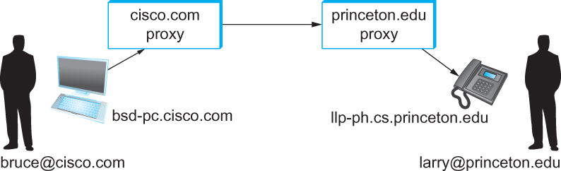
Multimedia Applications
SIP
Establishing communication through SIP proxies.
Notes:
The University of Adelaide, School of Computer Science
Chapter 2 — Instructions: Language of the Computer

Slide 50
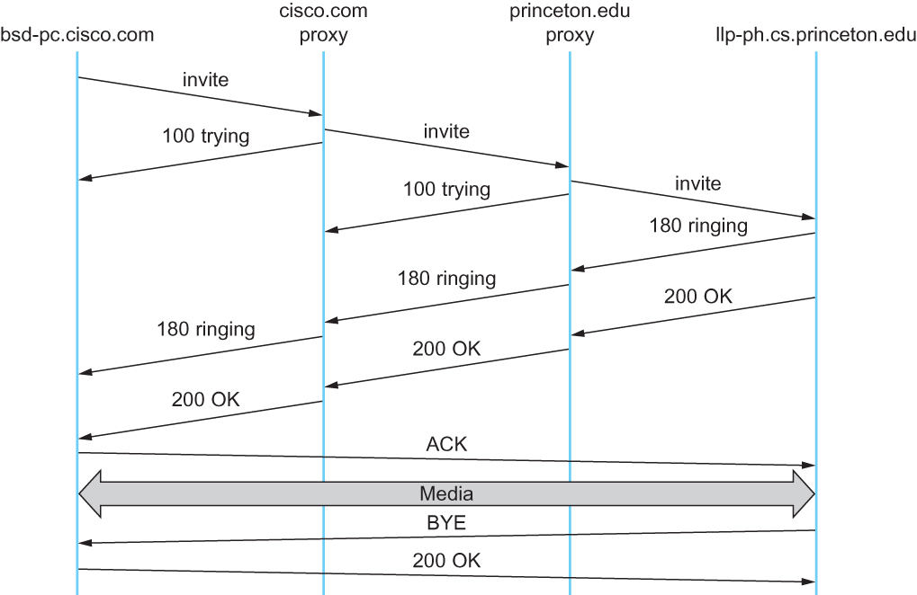
Multimedia Applications
SIP
Message flow for a basic SIP session
Notes:
The University of Adelaide, School of Computer Science
Chapter 2 — Instructions: Language of the Computer

Slide 51
Multimedia Applications
H.323
  The ITU has also been very active in the call control area, which is not surprising given its relevance to telephony, the traditional realm of that body.
  Fortunately, there has been considerable coordination between the IETF and the ITU in this instance, so that the various protocols are somewhat interoperable.
  The major ITU recommendation for multimedia communication over packet networks is known as H.323, which ties together many other recommendations, including H.225 for call control.
  The full set of recommendations covered by H.323 runs to many hundreds of pages, and the protocol is known for its complexity
Notes:
The University of Adelaide, School of Computer Science
Chapter 2 — Instructions: Language of the Computer

Slide 52
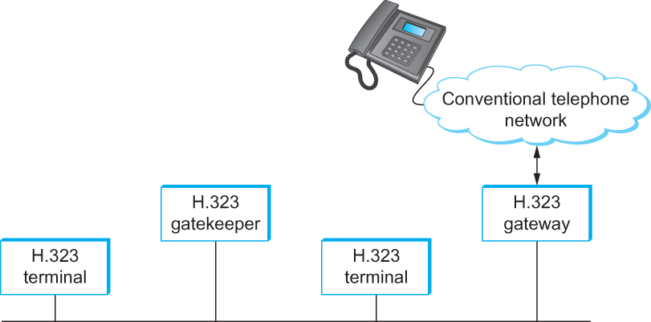
Multimedia Applications
H.323
Devices in an H.323 network.
Notes:
The University of Adelaide, School of Computer Science
Chapter 2 — Instructions: Language of the Computer

Slide 53
Multimedia Applications
Resource Allocation for Multimedia Applications
  As we have just seen, session control protocols like SIP and H.323 can be used to initiate and control communication in multimedia applications, while RTP provides transport level functions for the data streams of the applications.
  A final piece of the puzzle in getting multimedia applications to work is making sure that suitable resources are allocated inside the network to ensure that the quality of service needs of the application are met.
  Differentiated Services can be used to provide fairly basic and scalable resource allocation to applications.
  A multimedia application can set the DSCP (differentiated services code point) in the IP header of the packets that it generates in an effort to ensure that both the media and control packets receive appropriate quality of service.
Notes:
The University of Adelaide, School of Computer Science
Chapter 2 — Instructions: Language of the Computer

Slide 54
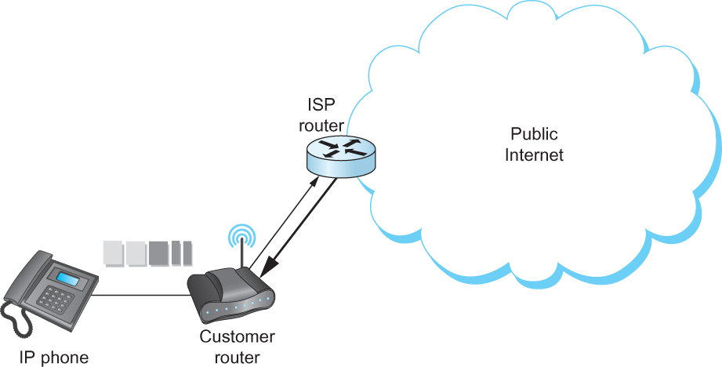
Multimedia Applications
Resource Allocation for Multimedia Applications
Differentiated Services applied to a VOIP application. DiffServ queueing is applied only on the upstream link from customer router to ISP.
Notes:
The University of Adelaide, School of Computer Science
Chapter 2 — Instructions: Language of the Computer

Slide 55
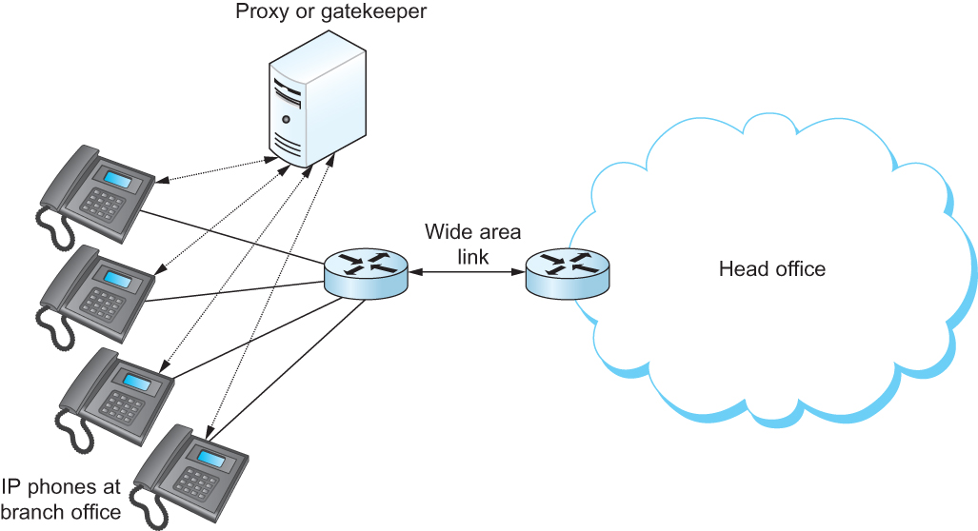
Multimedia Applications
Resource Allocation for Multimedia Applications
Admission control using session control protocol.
Notes:
The University of Adelaide, School of Computer Science
Chapter 2 — Instructions: Language of the Computer

Slide 56
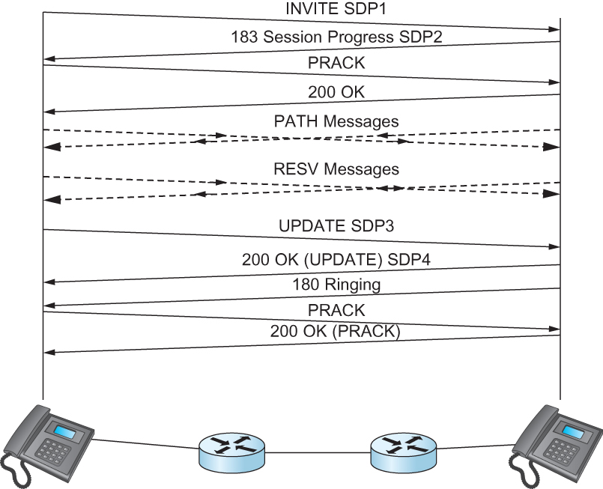
Multimedia Applications
Resource Allocation for Multimedia Applications
Co-ordination of SIP signalling and resource reservationl.
Notes:
The University of Adelaide, School of Computer Science
Chapter 2 — Instructions: Language of the Computer

Slide 57
Infrastructure Services
There are some protocols that are essential to the smooth running of the Internet, but that don’t fit neatly into the strictly layered model.
One of these is the Domain Name System (DNS)—not an application that users normally invoke explicitly, but rather a service that almost all other applications depend upon.
This is because the name service is used to translate host names into host addresses; the existence of such an application allows the users of other applications to refer to remote hosts by name rather than by address.
Notes:
The University of Adelaide, School of Computer Science
Chapter 2 — Instructions: Language of the Computer

Slide 58
Infrastructure Services
Name Service (DNS)
  In most of this book, we have been using addresses to identify hosts.
  While perfectly suited for processing by routers, addresses are not exactly user-friendly.
  It is for this reason that a unique name is also typically assigned to each host in a network.
  Host names differ from host addresses in two important ways.
    First, they are usually of variable length and mnemonic, thereby making them easier for humans to remember.
    Second, names typically contain no information that helps the network locate (route packets toward) the host.
Notes:
The University of Adelaide, School of Computer Science
Chapter 2 — Instructions: Language of the Computer

Slide 59
Infrastructure Services
Name Service (DNS)
  We first introduce some basic terminology.
    First, a name space defines the set of possible names.
      A name space can be either flat (names are not divisible into components), or it can be hierarchical (Unix file names are an obvious example).
    Second, the naming system maintains a collection of bindings of names to values. The value can be anything we want the naming system to return when presented with a name; in many cases it is an address.
    Finally, a resolution mechanism is a procedure that, when invoked with a name, returns the corresponding value. A name server is a specific implementation of a resolution mechanism that is available on a network and that can be queried by sending it a message.
Notes:
The University of Adelaide, School of Computer Science
Chapter 2 — Instructions: Language of the Computer

Slide 60
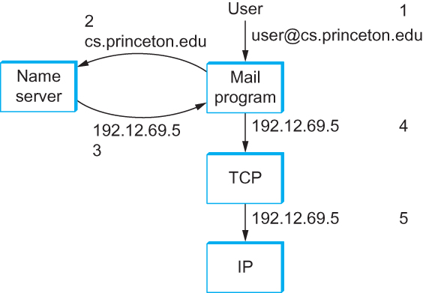
Infrastructure Services
Name Service (DNS)
Names translated into addresses, where the numbers 1–5 show the sequence of steps in the process
Notes:
The University of Adelaide, School of Computer Science
Chapter 2 — Instructions: Language of the Computer

Slide 61
Infrastructure Services
Domain Hierarchy
  DNS implements a hierarchical name space for Internet objects. Unlike Unix file names, which are processed from left to right with the naming components separated with slashes, DNS names are processed from right to left and use periods as the separator.
  Like the Unix file hierarchy, the DNS hierarchy can be visualized as a tree, where each node in the tree corresponds to a domain, and the leaves in the tree correspond to the hosts being named.
Notes:
The University of Adelaide, School of Computer Science
Chapter 2 — Instructions: Language of the Computer

Slide 62
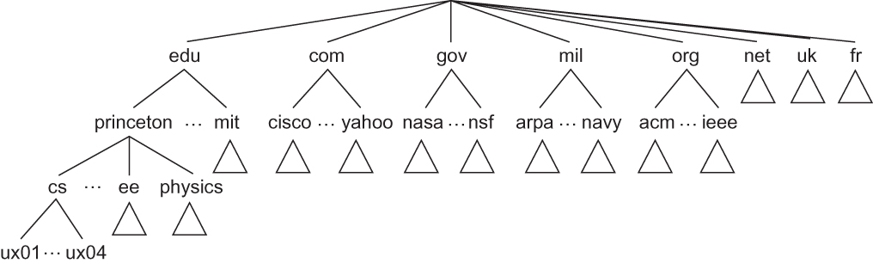
Infrastructure Services
Domain Hierarchy
Example of a domain hierarchy
Notes:
The University of Adelaide, School of Computer Science
Chapter 2 — Instructions: Language of the Computer

Slide 63
Infrastructure Services
Name Servers
  The complete domain name hierarchy exists only in the abstract.
  We now turn our attention to the question of how this hierarchy is actually implemented.
  The first step is to partition the hierarchy into subtrees called zones.
  Each zone can be thought of as corresponding to some administrative authority that is responsible for that portion of the hierarchy.
  For example, the top level of the hierarchy forms a zone that is managed by the Internet Corporation for Assigned Names and Numbers (ICANN).
Notes:
The University of Adelaide, School of Computer Science
Chapter 2 — Instructions: Language of the Computer

Slide 64
Infrastructure Services
Name Servers
  Each name server implements the zone information as a collection of resource records.
  In essence, a resource record is a name-to-value binding, or more specifically a 5-tuple that contains the following fields:
  <Name, Value, Type, Class, TTL >
Notes:
The University of Adelaide, School of Computer Science
Chapter 2 — Instructions: Language of the Computer

Slide 65
Infrastructure Services
Name Servers
  The Name and Value fields are exactly what you would expect, while the Type field specifies how the Value should be interpreted.
    For example, Type = A indicates that the Value is an IP address. Thus, A records implement the name-to-address mapping we have been assuming. Other record types include
    NS: The Value field gives the domain name for a host that is running a name
    server that knows how to resolve names within the specified domain.
    CNAME: The Value field gives the canonical name for a particular host; it is
    used to define aliases.
    MX: The Value field gives the domain name for a host that is running a mail
    server that accepts messages for the specified domain.
Notes:
The University of Adelaide, School of Computer Science
Chapter 2 — Instructions: Language of the Computer

Slide 66
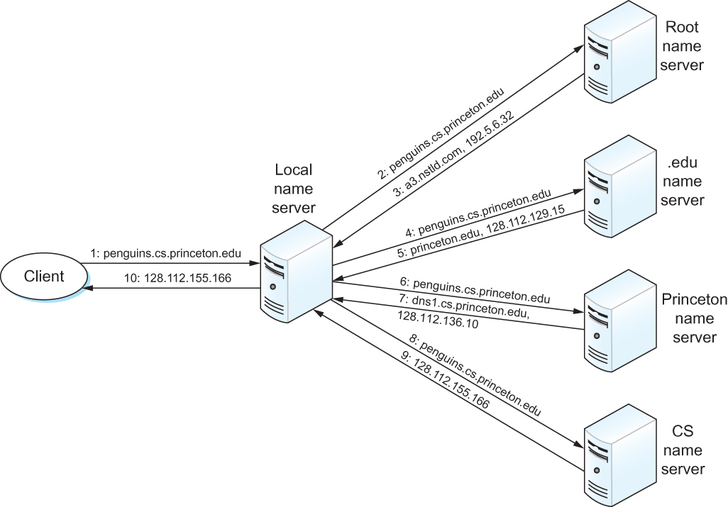
Infrastructure Services
Name Resolution
Name resolution in practice, where the numbers 1–10 show the sequence of steps in the process.
Notes:
The University of Adelaide, School of Computer Science
Chapter 2 — Instructions: Language of the Computer

Slide 67
Infrastructure Services
Network Management
  A network is a complex system, both in terms of the number of nodes that are involved and in terms of the suite of protocols that can be running on any one node.
  Even if you restrict yourself to worrying about the nodes within a single administrative domain, such as a campus, there might be dozens of routers and hundreds—or even thousands—of hosts to keep track of. If you think about all the state that is maintained and manipulated on any one of those nodes—for example, address translation tables, routing tables, TCP connection state, and so on—then it is easy to become depressed about the prospect of having to manage all of this information
Notes:
The University of Adelaide, School of Computer Science
Chapter 2 — Instructions: Language of the Computer

Slide 68
Infrastructure Services
Network Management
  The most widely used protocol for this purpose is the Simple Network Management Protocol (SNMP).
  SNMP is essentially a specialized request/reply protocol that supports two kinds of request messages: GET and SET.
  The former is used to retrieve a piece of state from some node, and the latter is used to store a new piece of state in some node.
  SNMP is used in the obvious way.
    A system administrator interacts with a client program that displays information about the network.
    This client program usually has a graphical interface. Whenever the administrator selects a certain piece of information that he or she wants to see, the client program uses SNMP to request that information from the node in question. (SNMP runs on top of UDP.)
    An SNMP server running on that node receives the request, locates the appropriate piece of information, and returns it to the client program, which then displays it to the user.
Notes:
The University of Adelaide, School of Computer Science
Chapter 2 — Instructions: Language of the Computer

Slide 69
Overlay Network
In the last few years, the distinction between packet forwarding and application processing has become less clear.
New applications are being distributed across the Internet, and in many cases, these applications make their own forwarding decisions.
These new hybrid applications can sometimes be implemented by extending traditional routers and switches to support a modest amount of application-specific processing.
For example, so called level-7 switches sit in front of server clusters and forward HTTP requests to a specific server based on the requested URL.
Notes:
The University of Adelaide, School of Computer Science
Chapter 2 — Instructions: Language of the Computer

Slide 70
Overlay Network
However, overlay networks are quickly emerging as the mechanism of choice for introducing new functionality into the Internet
You can think of an overlay as a logical network implemented on top of a some underlying network.
  By this definition, the Internet started out as an overlay network on top of the links provided by the old telephone network
Each node in the overlay also exists in the underlying network; it processes and forwards packets in an application-specific way.
The links that connect the overlay nodes are implemented as tunnels through the underlying network.
Notes:
The University of Adelaide, School of Computer Science
Chapter 2 — Instructions: Language of the Computer

Slide 71
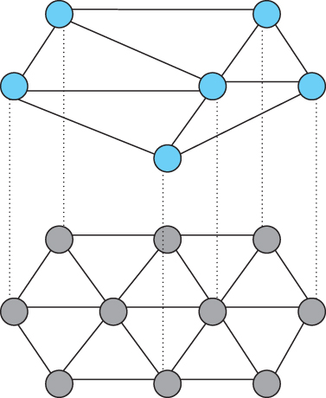
Overlay Network
Overlay network layered on top of a physical network
Notes:
The University of Adelaide, School of Computer Science
Chapter 2 — Instructions: Language of the Computer

Slide 72
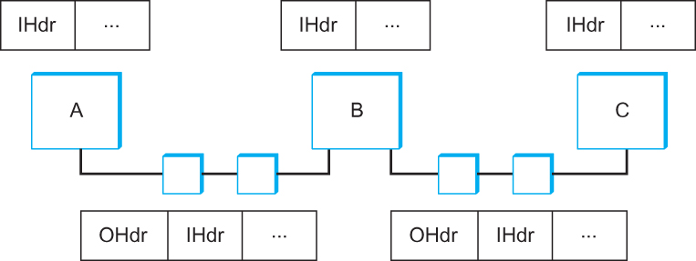
Overlay Network
Overlay nodes tunnel through physical nodes
Notes:
The University of Adelaide, School of Computer Science
Chapter 2 — Instructions: Language of the Computer

Slide 73
Overlay Network
Routing Overlays
  The simplest kind of overlay is one that exists purely to support an alternative routing strategy; no additional application-level processing is performed at the overlay nodes.
  You can view a virtual private network as an example of a routing overlay.
  In this particular case, the overlay is said to use “IP tunnels”, and the ability to utilize these VPNs is supported in many commercial routers.
Notes:
The University of Adelaide, School of Computer Science
Chapter 2 — Instructions: Language of the Computer

Slide 74
Overlay Network
Routing Overlays
  Suppose, however, you wanted to use a routing algorithm that commercial router vendors were not willing to include in their products.
  How would you go about doing it?
    You could simply run your algorithm on a collection of end hosts, and tunnel through the Internet routers.
    These hosts would behave like routers in the overlay network: as hosts they are probably connected to the Internet by only one physical link, but as a node in the overlay they would be connected to multiple neighbors via tunnels.
Notes:
The University of Adelaide, School of Computer Science
Chapter 2 — Instructions: Language of the Computer

Slide 75
Overlay Network
Routing Overlays
  Experimental Versions of IP
    Overlays are ideal for deploying experimental versions of IP that you hope will eventually take over the world.
    For example, IP multicast started off as an extension to IP and even today is not enabled in many Internet routers.
    The Mbone (multicast backbone) was an overlay network that implemented IP multicast on top of the unicast routing provided by the Internet.
    A number of multimedia conference tools were developed for and deployed on the Mbone.
    For example, IETF meetings—which are a week long and attract thousands of participants—were for many years broadcast over the MBone.
Notes:
The University of Adelaide, School of Computer Science
Chapter 2 — Instructions: Language of the Computer

Slide 76
Overlay Network
Routing Overlays
  End System Multicast
    Although IP multicast is popular with researchers and certain segments of the networking community, its deployment in the global internet has been limited at best.
    In response, multicast-based applications like videoconferencing have recently turned to an alternative strategy, called end system multicast.
    The idea of end system multicast is to accept that IP multicast will never become ubiquitous, and to instead let the end hosts that are participating in a particular multicast-based application implement their own multicast trees.
Notes:
The University of Adelaide, School of Computer Science
Chapter 2 — Instructions: Language of the Computer

Slide 77
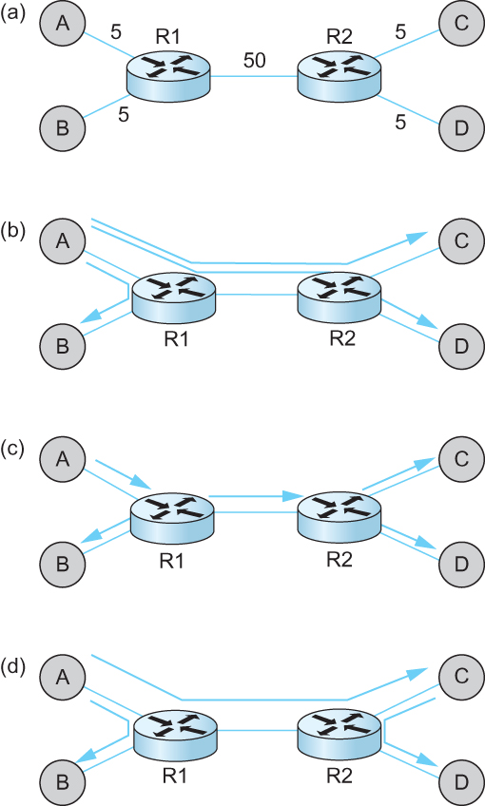
Overlay Network
Routing Overlays
  End System Multicast
(a) depicts an example physical topology, where R1 and R2 are routers connected by a low-bandwidth transcontinental link; A, B, C, and D are end hosts; and
link delays are given as edge weights. Assuming A wants to send a multicast message to the other three hosts,
(b) shows how naive unicast transmission would
work. This is clearly undesirable because the same message must traverse the link A–R1 three times, and two copies of the message traverse R1–R2.
(c) depicts the IP multicast tree constructed by DVMRP. Clearly, this approach eliminates the redundant
messages. Without support from the routers, however, the best one can hope for with end system multicast is a tree similar to the one shown in (d). End system multicast defines an architecture for constructing this tree.
Notes:
The University of Adelaide, School of Computer Science
Chapter 2 — Instructions: Language of the Computer

Slide 78
Overlay Network
Routing Overlays
  End System Multicast
    The general approach is to support multiple levels of overlay networks, each of which extracts a subgraph from the overlay below it, until we have selected the subgraph that the application expects.
    For end system multicast in particular, this happens in two stages: first we construct a simple mesh overlay on top of the fully connected Internet, and then we select a multicast tree within this mesh.
Notes:
The University of Adelaide, School of Computer Science
Chapter 2 — Instructions: Language of the Computer

Slide 79
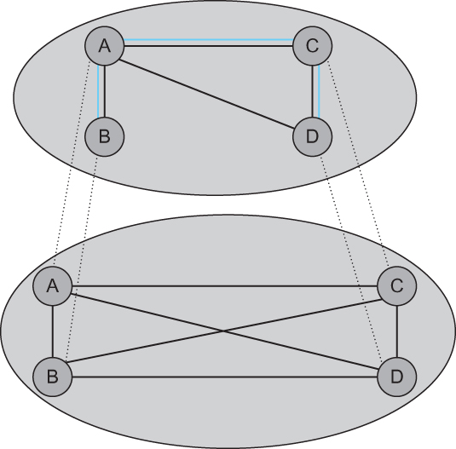
Overlay Network
Routing Overlays
  End System Multicast
Multicast tree embedded in an overlay mesh
Notes:
The University of Adelaide, School of Computer Science
Chapter 2 — Instructions: Language of the Computer

Slide 80
Overlay Network
Resilient Overlay Networks
  Another function that can be performed by an overlay is to find alternative routes for traditional unicast applications.
  Such overlays exploit the observation that the triangle inequality does not hold in the Internet
Notes:
The University of Adelaide, School of Computer Science
Chapter 2 — Instructions: Language of the Computer

Slide 81
Overlay Network
Peer-to-peer Networks
  Music-sharing applications like Napster and KaZaA introduced the term “peer-to-peer” into the popular vernacular.
  Attributes like decentralized and self-organizing are mentioned when discussing peer-to-peer networks, meaning that individual nodes organize themselves into a network without any centralized coordination
Notes:
The University of Adelaide, School of Computer Science
Chapter 2 — Instructions: Language of the Computer

Slide 82
Overlay Network
Peer-to-peer Networks
  What’s interesting about peer-to-peer networks?
    One answer is that both the process of locating an object of interest and the process of downloading that object onto your local machine happen without your having to contact a centralized authority, and at the same time, the system is able to scale to millions of nodes.
    A peer-to-peer system that can accomplish these two tasks in a decentralized manner turns out to be an overlay network, where the nodes are those hosts that are willing to share objects of interest (e.g., music and other assorted files), and the links (tunnels) connecting these nodes represent the sequence of machines that you have to visit to track down the object you want.
Notes:
The University of Adelaide, School of Computer Science
Chapter 2 — Instructions: Language of the Computer

Slide 83
Overlay Network
Peer-to-peer Networks
  Gnutella
    Gnutella is an early peer-to-peer network that attempted to distinguish between exchanging music (which likely violates somebody’s copyright) and the general sharing of files (which must be good since we’ve been taught to share since the age of two).
    What’s interesting about Gnutella is that it was one of the first such systems to not depend on a centralized registry of objects.
    Instead Gnutella participants arrange themselves into an overlay network.
Notes:
The University of Adelaide, School of Computer Science
Chapter 2 — Instructions: Language of the Computer

Slide 84
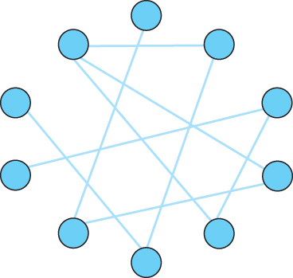
Overlay Network
Peer-to-peer Networks
  Gnutella
Example topology of a Gnutella peer-to-peer network
Notes:
The University of Adelaide, School of Computer Science
Chapter 2 — Instructions: Language of the Computer

Slide 85
Overlay Network
Peer-to-peer Networks
  Structured Overlays
    At the same time file sharing systems have been fighting to fill the void left by Napster, the research community has been exploring an alternative design for peer-to-peer networks.
    We refer to these networks as structured, to contrast them with the essentially random (unstructured) way in which a Gnutella network evolves.
    Unstructured overlays like Gnutella employ trivial overlay construction and maintenance algorithms, but the best they can offer is unreliable, random search.
    In contrast, structured overlays are designed to conform to a particular graph structure that allows reliable and efficient object location, in return for additional complexity during overlay construction and maintenance..
Notes:
The University of Adelaide, School of Computer Science
Chapter 2 — Instructions: Language of the Computer

Slide 86
Overlay Network
Peer-to-peer Networks
  Structured Overlays
    If you think about what we are trying to do at a high level, there are two questions to consider:
      (1) how do we map objects onto nodes, and
      (2) how do we route a request to the node that is responsible for a given object.
      We start with the first question, which has a simple statement: how do we map an object with name x into the address of some node n that is able to serve that object?
      While traditional peer-to-peer networks have no control over which node hosts object x, if we could control how objects get distributed over the network, we might be able to do a better job of finding those objects at a later time.
Notes:
The University of Adelaide, School of Computer Science
Chapter 2 — Instructions: Language of the Computer

Slide 87
Overlay Network
Peer-to-peer Networks
  Structured Overlays
    A well-known technique for mapping names into address is to use a hash table, so that
      hash(x) → n
    implies object x is first placed on node n, and at a later time, a client trying to locate x would only have to perform the hash of x to determine that it is on node n.
    A hash-based approach has the nice property that it tends to spread the objects evenly across the set of nodes, but straightforward hashing algorithms suffer from a fatal flaw: how many possible values of n should we allow?
    Naively, we could decide that there are, say, 101 possible hash values, and we use a modulo hash function; that is,
      hash(x)
      return x % 101.
Notes:
The University of Adelaide, School of Computer Science
Chapter 2 — Instructions: Language of the Computer

Slide 88
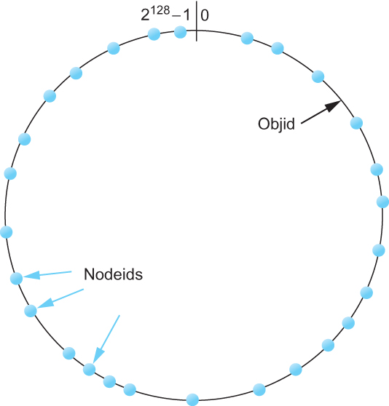
Overlay Network
Peer-to-peer Networks
  Structured Overlays
Both nodes and objects map (hash) onto the id space, where objects are maintained at the nearest node in this space.
Notes:
The University of Adelaide, School of Computer Science
Chapter 2 — Instructions: Language of the Computer

Slide 89
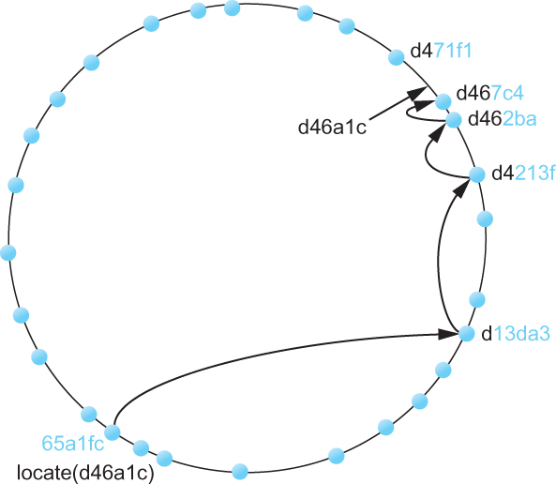
Overlay Network
Peer-to-peer Networks
  Structured Overlays
Objects are located by routing through the peer-to-peer overlay network.
Notes:
The University of Adelaide, School of Computer Science
Chapter 2 — Instructions: Language of the Computer

Slide 90
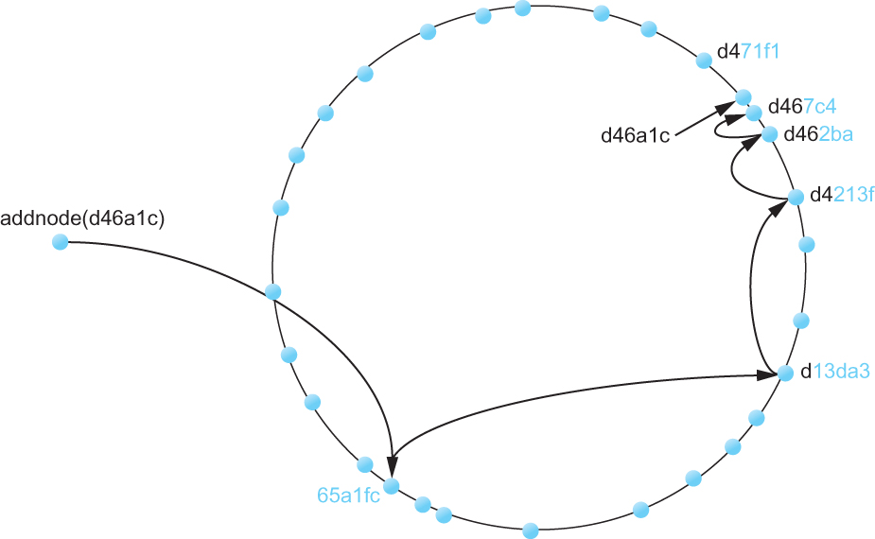
Overlay Network
Peer-to-peer Networks
  Structured Overlays
Adding a node to the network
Notes:
The University of Adelaide, School of Computer Science
Chapter 2 — Instructions: Language of the Computer

Slide 91
Overlay Network
Peer-to-peer Networks
  BitTorrent
    BitTorrent is a peer-to-peer file sharing protocol devised by Bram Cohen.
    It is based on replicating the file, or rather, replicating segments of the file, which are called pieces.
    Any particular piece can usually be downloaded from multiple peers, even if only one peer has the entire file.
    The primary benefit of BitTorrent’s replication is avoiding the bottleneck of having only one source for a file. This is particularly useful when you consider that any given computer has a limited speed at which it can serve files over its uplink to the Internet, often quite a low limit due to the asymmetric nature of most broadband networks.
Notes:
The University of Adelaide, School of Computer Science
Chapter 2 — Instructions: Language of the Computer

Slide 92
Overlay Network
Peer-to-peer Networks
  BitTorrent
    The beauty of BitTorrent is that replication is a natural side-effect of the downloading process: as soon as a peer downloads a particular piece, it becomes another source for that piece.
    The more peers downloading pieces of the file, the more piece replication occurs, distributing the load proportionately, and the more total bandwidth is available to share the file with others.
    Pieces are downloaded in random order to avoid a situation where peers find themselves lacking the same set of pieces.
Notes:
The University of Adelaide, School of Computer Science
Chapter 2 — Instructions: Language of the Computer

Slide 93
Overlay Network
Peer-to-peer Networks
  BitTorrent
    Each file is shared via its own independent BitTorrent network, called a swarm.(A swarm could potentially share a set of files, but we describe the single file case for simplicity.)
    The lifecycle of a typical swarm is as follows. The swarm starts as a singleton peer with a complete copy of the file.
    A node that wants to download the file joins the swarm, becoming its second member, and begins downloading pieces of the file from the original peer.
    In doing so, it becomes another source for the pieces it hasdownloaded, even if it has not yet downloaded the entire file.
Notes:
The University of Adelaide, School of Computer Science
Chapter 2 — Instructions: Language of the Computer

Slide 94
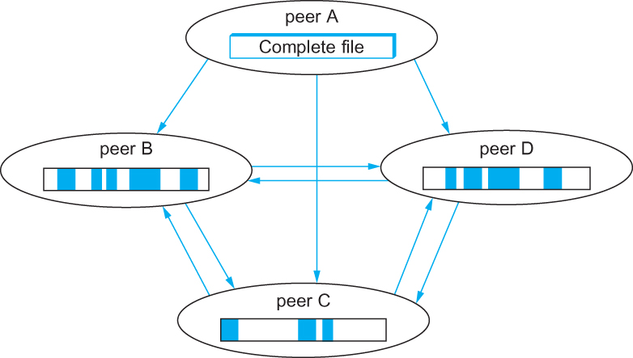
Overlay Network
Peer-to-peer Networks
  BitTorrent
Peers in a BitTorrent swarm download from other peers that may not yet have the complete file
Notes:
The University of Adelaide, School of Computer Science
Chapter 2 — Instructions: Language of the Computer

Slide 95
Overlay Network
Content Distribution Network (CDN)
  The idea of a CDN is to geographically distribute a collection of server surrogates that cache pages normally maintained in some set of backend servers
    Akamai operates what is probably the best-known CDN.
  Thus, rather than have millions of users wait forever to contact www.cnn.com when a big news story breaks—such a situation is known as a flash crowd—it is possible to spread this load across many servers.
  Moreover, rather than having to traverse multiple ISPs to reach www.cnn.com, if these surrogate servers happen to be spread across all the backbone ISPs, then it should be possible to reach one without having to cross a peering point.
Notes:
The University of Adelaide, School of Computer Science
Chapter 2 — Instructions: Language of the Computer

Slide 96
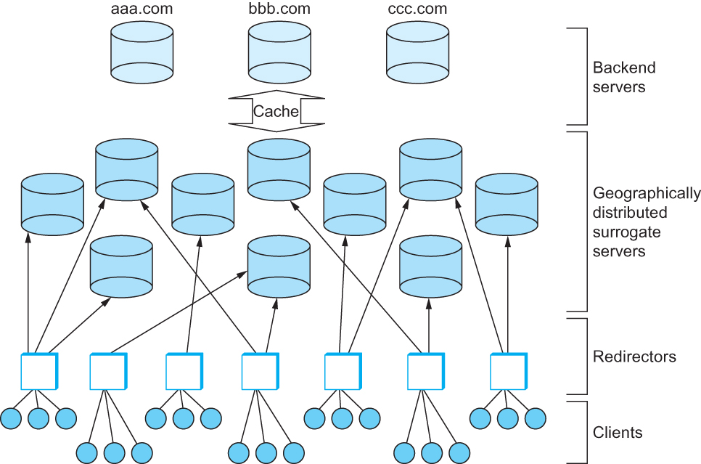
Overlay Network
Content Distribution Network (CDN)
Components in a Content Distribution Network (CDN).
Notes:
The University of Adelaide, School of Computer Science
Chapter 2 — Instructions: Language of the Computer

Slide 97
Summary
We have discussed some of the popular applications in the Internet
  Electronic mail, World Wide Web
We have discussed multimedia applications
We have discussed infrastructure services
  Domain Name Services (DNS)
We have discussed overlay networks
  Routing overlay, End-system multicast, Peer-to-peer networks
We have discussed content distribution networks
Notes:
The University of Adelaide, School of Computer Science
Chapter 2 — Instructions: Language of the Computer

